Slide 1
IBM Capstone Project
A Deep Dive into Technology Trends and Demographics
Presented by: Avik Sarkhel

Slide 2

Introduction
Overview:
This presentation showcases insights from the IBM Capstone Project dataset, which contains 18,821 respondents.
The original dataset had 114 columns and 18,845 rows, but after cleaning and transformation, 24 records with "Prefer not to say" age values were removed.
The project was initially designed for Google Looker Studio, but this analysis was conducted using Power BI, modifying the provided questionnaire to enhance insights.
Purpose of the Analysis:
Understand current technology usage and preferences in programming languages, databases, web frameworks, and platforms.
Identify future technology adoption trends, helping professionals and businesses prepare for emerging shifts.
Explore respondent demographics to understand how age, education, and geography influence technology adoption.

Slide 3
Project Overview
Dataset: Originally contained 114 columns & 18,845 rows; cleaned dataset now has 18,821 respondents.
Goal: To analyze technology usage trends and respondent demographics.
Methodology:
Data Cleaning: Removed irrelevant columns, handled multi-value responses.
Data Transformation: Split multi-value responses (e.g., languages, databases) using Power BI.
Dashboard Creation: Designed 3 dashboards focusing on Current Usage, Future Trends, and Demographics.

Slide 4
Data Preparation & Transformation
Data Loading: Imported dataset into Power BI.
Query Duplication: Created 3 separate queries, each cleaned for specific dashboard needs.
Handling Multi-Value Fields:
Columns like Languages Used and Databases Used contained multiple values separated by semicolons.
Used split by rows to normalize data for accurate visualization.
Demographics Adjustments:
Removed 24 records where respondents marked "Prefer not to say" for age.
Ensured consistency in country and education-level classification.

Slide 5
Questionaire and modifications to the original project structure
The original questionnaire provided a structured approach to analyzing technology usage, future trends, and demographics. To enhance clarity and improve insight extraction, modifications were made by adjusting visualization types and removing redundant elements. Below is a comparison of the original and modified questionnaire :
Category | Original Visualization | Modified Visualization
Current Technology Usage | Top 10 Languages Used (Stacked Bar Chart) Top 10 Databases Used (Stacked Column Chart) Top 10 Platforms Used (Word Cloud) Top 10 Web Frameworks Used (Scatter Bubble) | Top 10 Languages Used (Horizontal Lollipop Chart) Top 10 Databases Used (Vertical Lollipop Chart) Top 10 Platforms Used (Funnel Chart) Top 10 Web Frameworks Used (Pie Chart)
Future Technology Trends | Top 10 Languages Used (Stacked Bar Chart) Top 10 Databases Used (Stacked Column Chart) Top 10 Platforms Used (Tree map) Top 10 Web Frameworks Used (Scatter Bubble) | Top 10 Languages Desired (Horizontal Lollipop Chart) Top 10 Databases Desired (Vertical Lollipop Chart) Top 10 Platforms Desired (Funnel Chart) Top 10 Web Frameworks Desired (Pie Chart)
Demographics | Respondents by Age (Pie Chart) Respondent Count by Country (Map Chart) Respondent Distribution by Education (Line Bar Chart) Respondent Count by Age, Classified by Education Level (Stacked Bar Chart) | Respondents by Age (Horizontal Lollipop Chart) Respondent Count by Country (Map Chart) Respondent Distribution by Education (Vertical Lollipop Chart) Removed (Covered by above visuals)

Slide 6
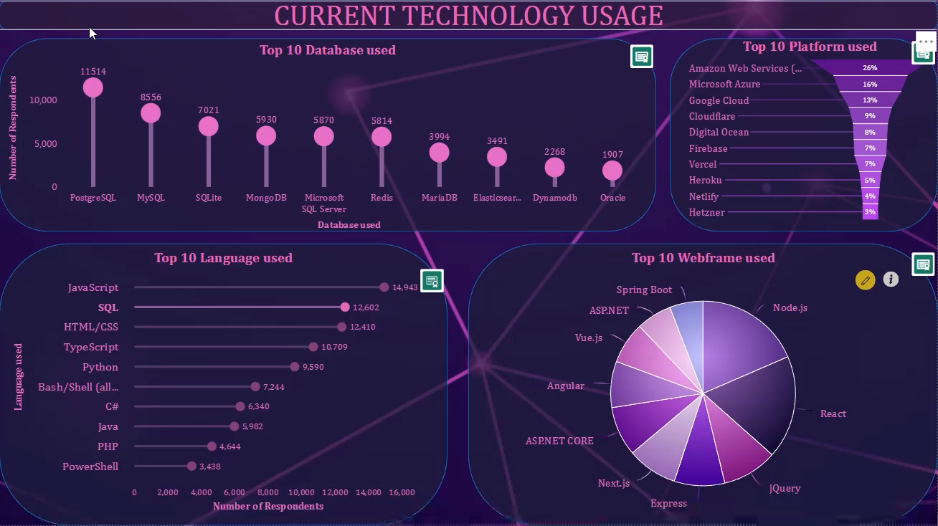
Data Visualisation

Slide 7
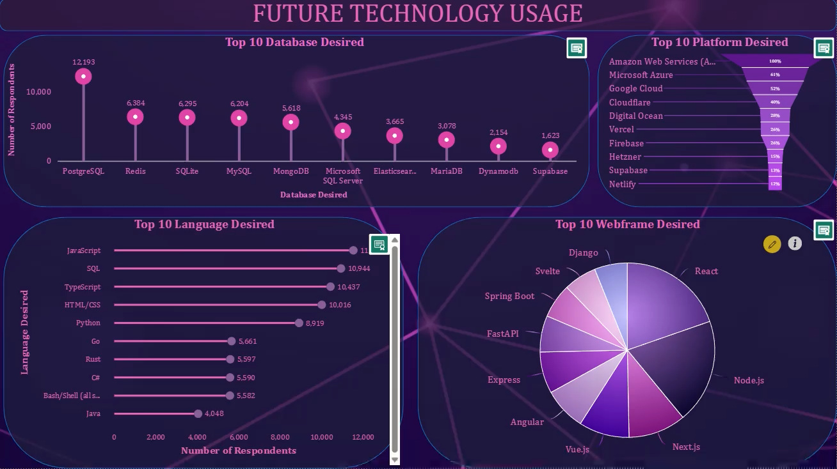
Data Visualisation

Slide 8
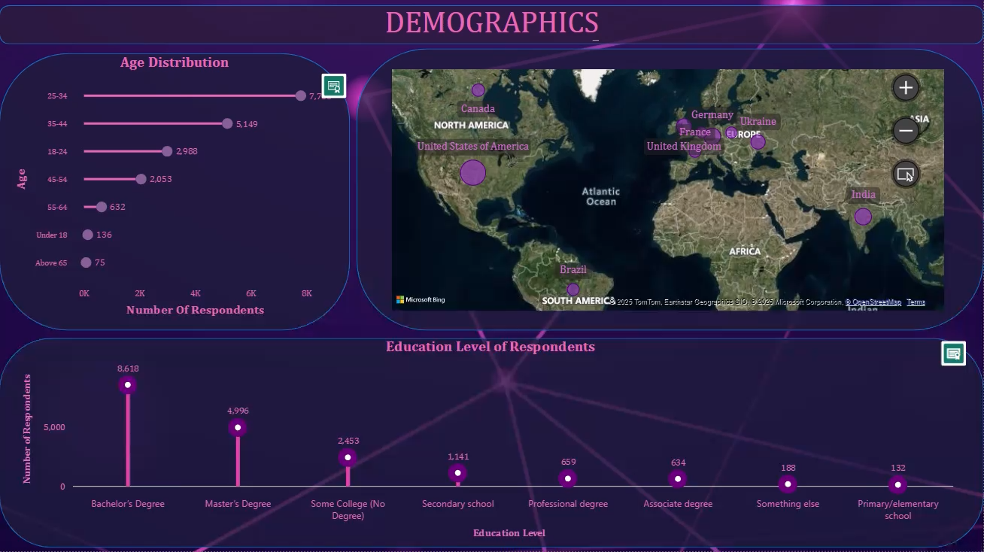
Data Visualisation

Slide 9
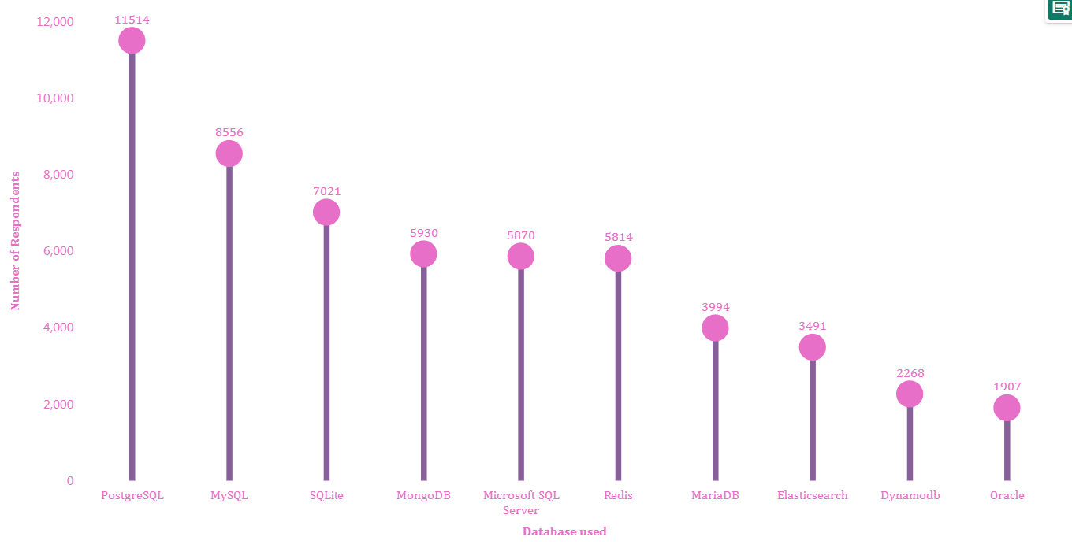
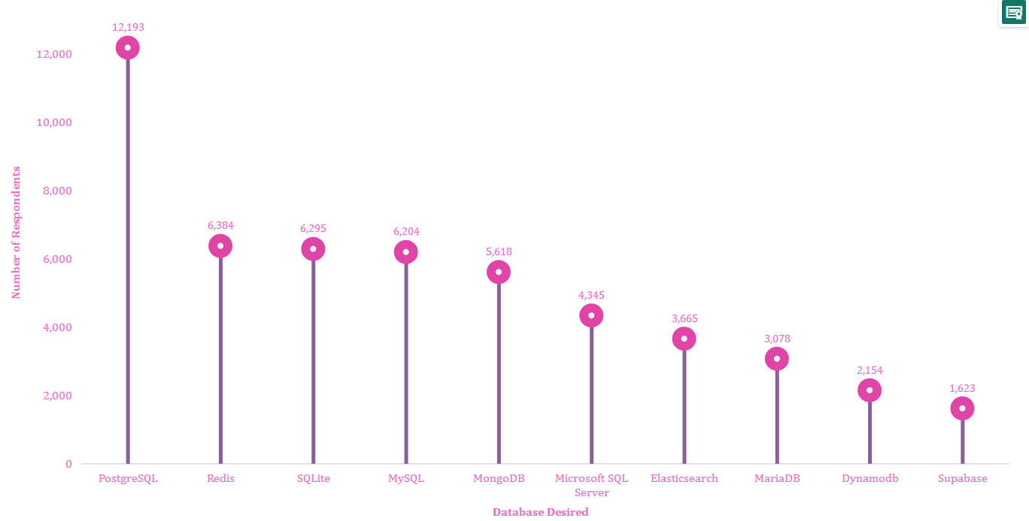
Comparison of Current and Desired Database Usage
Analysis:
PostgreSQL remains the most used and most desired database, showing its strong preference among developers.
MySQL, currently the second most used, sees a lower ranking in desired databases, suggesting a potential shift in preference.
SQLite and Redis gain popularity in future preferences, indicating their growing importance in development.
MongoDB and Microsoft SQL Server remain stable in both current and desired rankings.
Supabase appears in the desired list but not in the current top 10, indicating emerging interest.

Slide 10
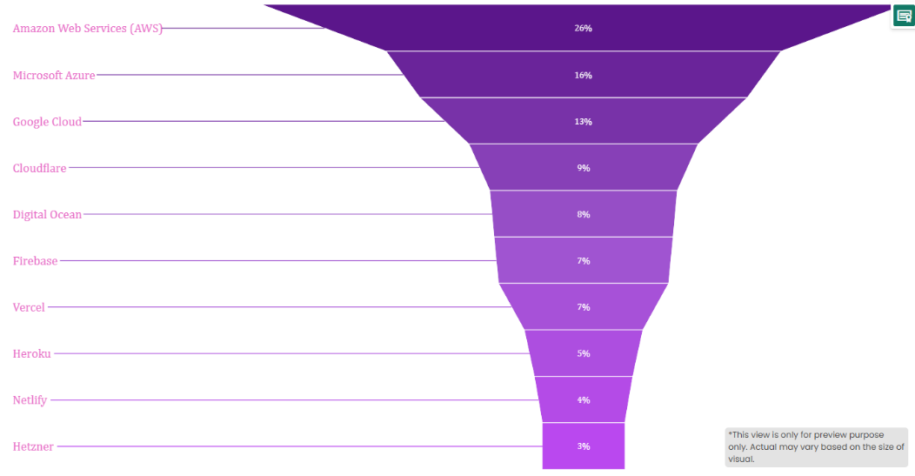
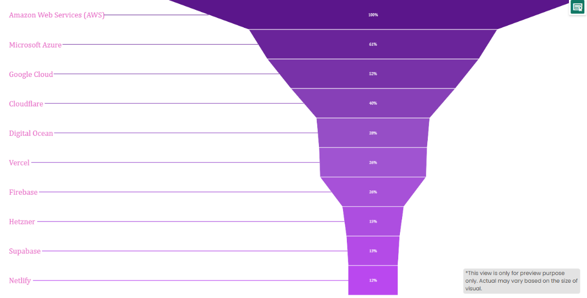
Comparison of Current and Desired Platform Usage
Analysis:
Amazon Web Services (AWS) remains the dominant platform in both current and desired usage, reinforcing its industry leadership.
Microsoft Azure and Google Cloud hold strong positions but see a shift in ranking, suggesting evolving preferences among developers.
Cloudflare maintains its relevance, but its future desirability is slightly lower.
Supabase emerges in the desired platforms list, indicating increasing interest in modern backend solutions.
DigitalOcean and Hetzner gain future traction, hinting at growing demand for cost-effective cloud solutions.

Slide 11
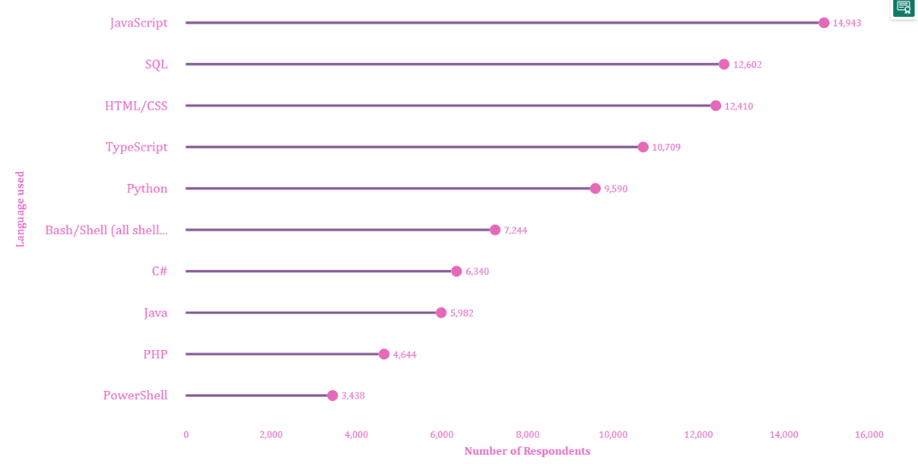
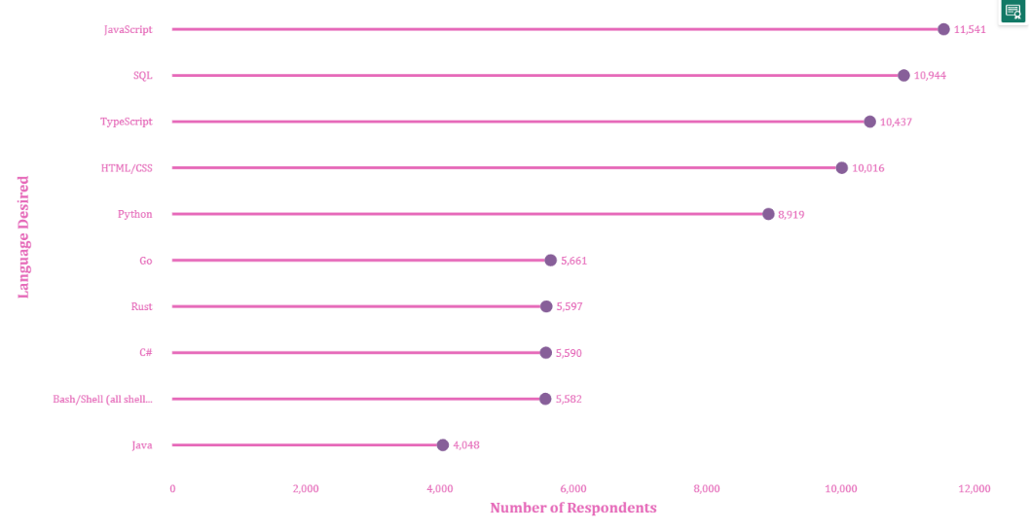
Comparison of Current vs. Desired Programming Languages
Analysis:
JavaScript remains the most used and desired language, reflecting its dominance in web development.
SQL sees a slight drop in desirability compared to current usage, indicating a potential shift in database management trends.
TypeScript and HTML/CSS remain highly relevant but show a moderate decline in future demand.
Go and Rust appear in the desired languages list, highlighting growing interest in modern, high-performance languages.
C# and Java see relatively stable demand, but Bash/Shell scripting experiences a slight decline in future preference.

Slide 12
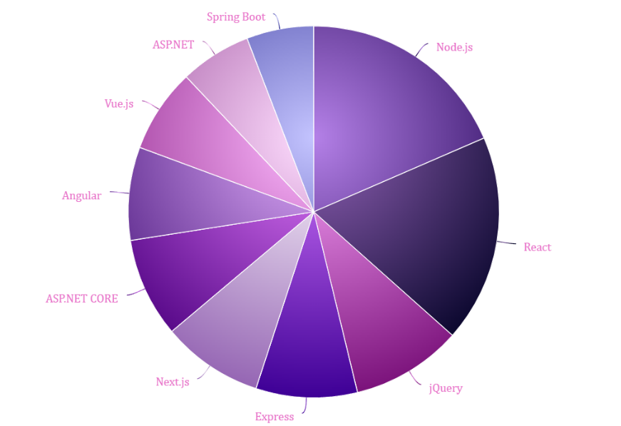
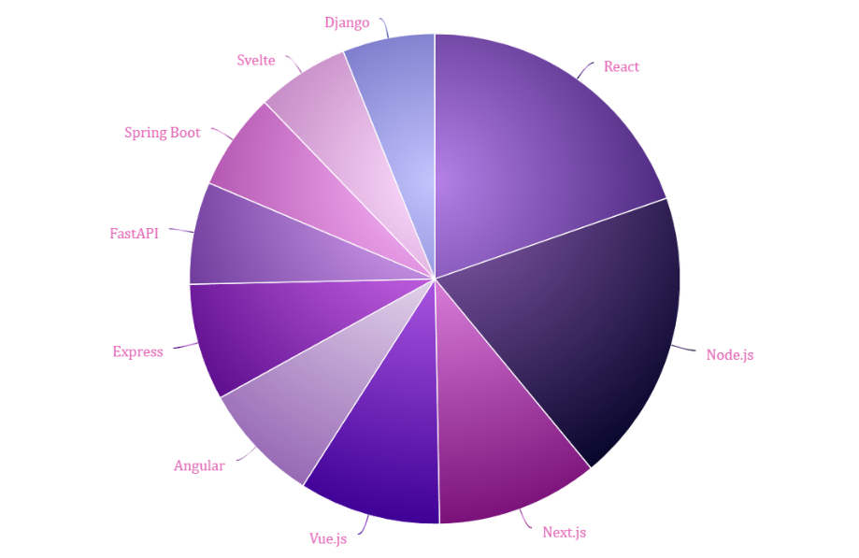
Comparison of Current vs. Desired Web Frame
Analysis:
React and Node.js remain dominant in both current and desired frameworks, showing their continued relevance.
ASP.NET and jQuery are present in current frameworks but are absent in the desired ones, indicating a shift away from older technologies.
Next.js and Vue.js continue to be popular choices, appearing in both lists.
FastAPI, Django, and Svelte emerge in the desired frameworks list, signaling increased interest in modern, lightweight, and efficient web frameworks.
Express and Spring Boot maintain their presence, showing their reliability for backend development.

Slide 13
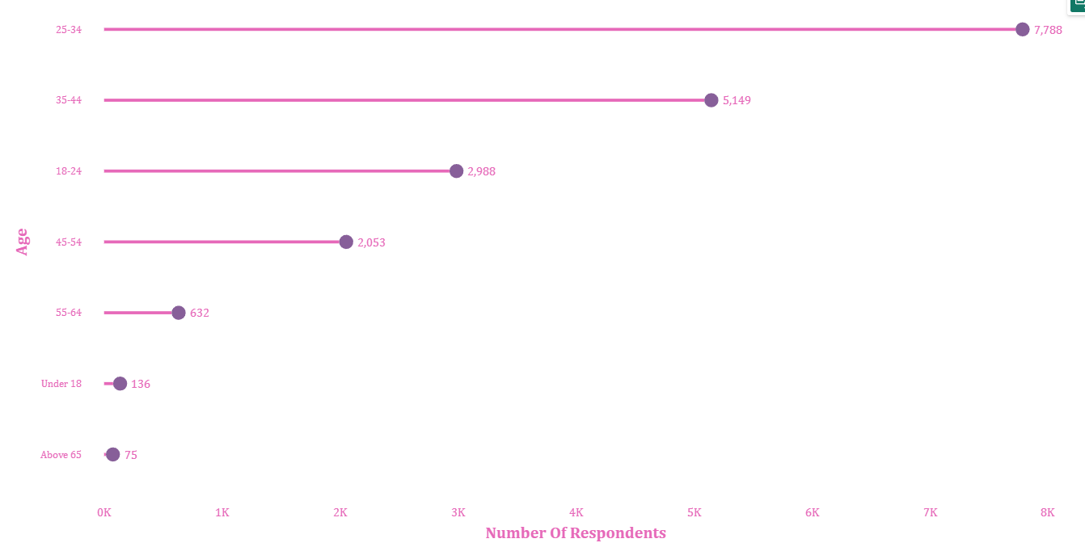
Age Distribution of Respondents
Analysis:
25-34 age group dominates with 7,788 respondents, making it the largest segment.
35-44 age group follows with 5,149 respondents, showing a significant presence.
18-24 age group has 2,988 respondents, indicating strong participation from young adults.
45-54 group has a moderate representation with 2,053 respondents.
Participation drops significantly for older age groups:
55-64: 632 respondents
Above 65: 75 respondents
Minimal participation from Under-18 with just 136 respondents.

Slide 14
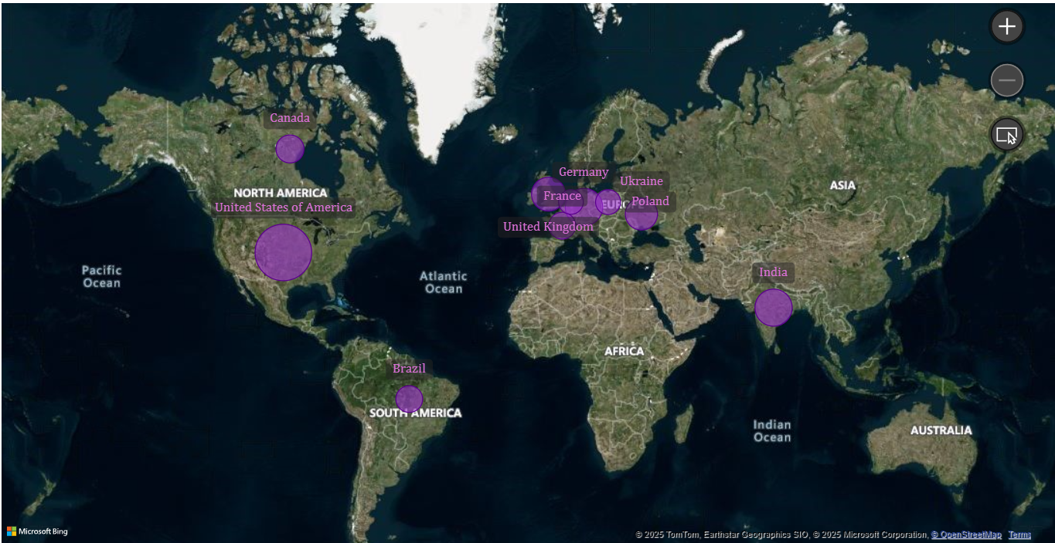
Geographic Distribution of Respondents
Analysis:
United States has the highest number of respondents (3,433), making up the largest segment.
Germany (1,338) and India (1,315) follow as the next largest contributors.
United Kingdom (1,052) and Ukraine (931) show significant participation.
Canada (659), France (598), and Brazil (587) contribute moderately.
Poland (494) and Netherlands (479) round out the top 10.

Slide 15
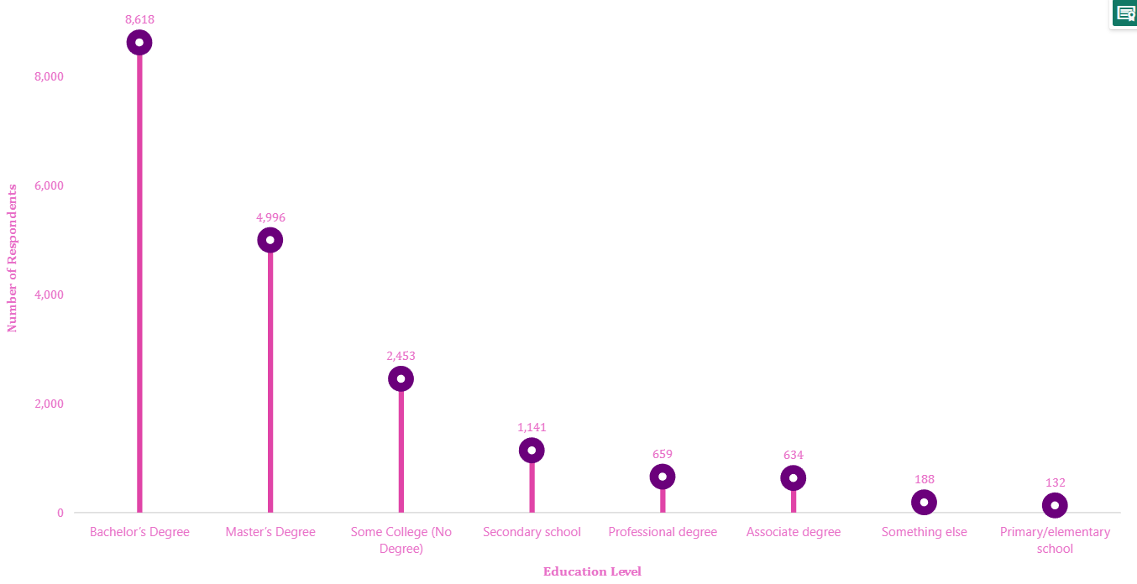
Educational Background of Respondents
Analysis:
Bachelor’s Degree holders (8,618) form the largest group, indicating a high level of formal education.
Master’s Degree (4,996) is the second most common, showing significant postgraduate education.
Some College, No Degree (2,453) and Secondary School (1,141) represent respondents with incomplete higher education.
Professional Degrees (659) and Associate Degrees (634) have relatively smaller representation.
Primary/Elementary School (132) and Something Else (188) indicate a minimal number of respondents with alternative education paths

Slide 16

Conclusions
In this Project a dataset of 18,821 respondents were analyzed to explore technology usage, future adoption trends, and demographics. The study focused on identifying the most used and desired programming languages, databases, cloud platforms, and web frameworks while also analyzing age distribution, geographic representation, and educational backgrounds. The data was transformed and visualized using Power BI, improving clarity and insight extraction.
The Key findings found from this project are:
Most used languages: JavaScript, Python, SQL; emerging: Go, Rust.
Top database: PostgreSQL; rising interest in: Supabase.
Cloud leader: AWS; growing interest in DigitalOcean, Hetzner.
Web frameworks: React, Node.js dominate; jQuery declining.
Major age group: 25-34 years.
Top countries: U.S., Germany, India.
Common education levels: Bachelor’s & Master’s degrees.
These insights help businesses and organizations identify future technology trends, refine hiring strategies, and make data-driven decisions on tech adoption.

Slide 17
Project Resources & Contact Information
GitHub Repository: (CLICK HERE) (For project files & code)
Google Drive Link: (CLICK HERE) (For large files that couldn’t be uploaded to GitHub)
Coursera Project Link: (CLICK HERE) (For reference to the original capstone project)
THANK YOU !!!!
Do you have any questions?
Write me at avik305sarkhel@gmail.com

